Slide 1
User-Defined Functions
Always returns a value
Can accept parameters
Can be nested

Slide 2
Create Functions
Function Name
DELIMITER $$
CREATE FUNCTION udf_project_weeks (start_date DATETIME, end_date DATETIME)
RETURNS INT
BEGIN
DECLARE project_weeks INT;
IF(end_date IS NULL) THEN
SET end_date := NOW();
END IF;
SET project_weeks := DATEDIFF(DATE(end_date), DATE(start_date)) / 7;
RETURN project_weeks;
END $$
Variable
Parameters
IF Statement
Return result

Slide 3
Execute Functions
Call function
SELECT p.project_id,
DATE(p.start_date) AS 'start_date',
DATE(p.end_date) AS 'end_date',
udf_project_weeks(p.start_date, p.end_date) AS 'project_weeks'
FROM projects AS p;
project_id | start_date | end_date | project_weeks
1 | 2003-06-01 | NULL | 732
2 | 2001-06-01 | 2003-06-01 | 104
3 | 2002-06-01 | 2003-06-01 | 52

Slide 4
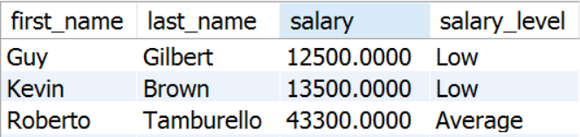

Problem: Salary Level Function
Write a function udf_get_salary_level(salary DECIMAL(19,4)) that receives salary of an employee and returns the level of the salary.
If salary is < 30000 return "Low"
If salary is between 30000 and 50000 (inclusive) return "Average"
If salary is > 50000 return "High"
Check your solution here: https://judge.softuni.bg/Contests/Practice/Index/302#4

Slide 5
Solution: Salary Level Function (1)
Function Name
Input Parameters
CREATE FUNCTION udf_get_salary_level(salary DECIMAL(19,4))
RETURNS VARCHAR(10)
BEGIN
-- Function logic here.
END;
Return Type
Function Body
Check your solution here: https://judge.softuni.bg/Contests/Practice/Index/298#4

Slide 6
Solution: Salary Level Function (2)
Variable
DECLARE salary_level VARCHAR(10); IF (salary < 30000) THEN
SET salary_level := 'Low';
ELSEIF(salary >= 30000 AND salary <= 50000) THEN
SET salary_level := 'Average';
ELSE
SET salary_level := 'High'; END IF;
RETURN salary_level;
IF Statement
Return Result
Check your solution here: https://judge.softuni.bg/Contests/Practice/Index/298#4

Slide 7
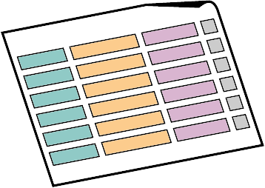


What is a Transaction?

Slide 8
Transactions
Transaction is a sequence of actions (database operations) executed as a whole:
Either all of them complete successfully or none of the them
Example of transaction:
A bank transfer from one account into another (withdrawal + deposit)
If either the withdrawal or the deposit fails the whole operation is cancelled

Slide 9
Transactions: Lifecycle (Rollback)
Read
Write
Durable starting state
Sequence of reads and writes
Durable,
consistent,
ending state
Write
Rollback

Slide 10
Transactions: Lifecycle (Commit)
Read
Write
Durable starting state
Sequence of reads and writes
Durable,
consistent,
ending state
Write
Commit

Slide 11
Transactions Behavior
Transactions guarantee the consistency and the integrity of the database.
All changes in a transaction are temporary.
Changes are persisted when COMMIT is executed.
At any time all changes can be canceled by ROLLBACK.
All of the operations are executed as a whole.

Slide 12


Checkpoints in games
DIE
Castle 1-1
Castle 1-2
Mario
SURVIVE

Slide 13


What are Transactions?
ROLLBACK
STATE 1
STATE 2
COMMIT
Queries
Notes:
Transaction is a sequence of actions (database operations) executed as a whole:
Either all of them complete successfully
Or none of the them
Example of transaction:
A bank transfer from one account into another (withdrawal + deposit)
If either the withdrawal or the deposit fails the whole operation is cancelled

Slide 14
Transactions Syntax
Start Transaction
START TRANSACTION
UPDATE accounts SET balance = balance – withdraw_amount
WHERE id = account
IF ROW_COUNT() <> 1 THEN -- Affected rows are different than one.
SIGNAL SQLSTATE '45000' SET MESSAGE_TEXT = 'Invalid account';
ROLLBACK;
ELSE
COMMIT;
END IF;
Withdraw Money
Undo Changes
Save Changes
Notes:
Start a transaction
BEGIN TRANSACTION
Some RDBMS use implicit start, e.g. Oracle
Ending a transaction
COMMIT
Complete a successful transaction and persist all changes made
ROLLBACK
“Undo” changes from an aborted transaction
May be done automatically when failure occurs

Slide 15


Transactions Properties
Modern DBMS servers have built-in transaction support.
Implement “ACID” transactions.
E.g. Oracle, MySQL, MS SQL Server, …
ACID means:
Atomicity
Consistency
Isolation
Durability

Slide 16

Stored Procedures

Slide 17
What are Stored Procedures?
Stored procedures
Encapsulate repetitive program logic.
Can accept input parameters.
Can return output results.
Benefits of stored procedures.
Share application logic.
Improved performance.
Reduced network traffic.

Slide 18
Creating Stored Procedures
CREATE PROCEDURE
Example:
Procedure Name
DELIMITER $$
CREATE PROCEDURE usp_select_employees_by_seniority()
BEGIN
SELECT *
FROM employees
WHERE ROUND((DATEDIFF(NOW(), hire_date) / 365.25)) < 15;
END $$
Procedure Logic

Slide 19
Executing Stored Procedures
Executing a stored procedure by CALL.
CALL usp_select_employees_by_seniority();

Slide 20
Dropping Stored Procedures
DROP PROCEDURE
DROP PROCEDURE usp_select_employees_by_seniority;

Slide 21

Stored Procedures
Using Parameters

Slide 22
Defining Parameterized Procedures
To define a parameterized procedure use the syntax:
CREATE PROCEDURE usp_procedure_name
(parameter_1_name parameter_type,
parameter_2_name parameter_type,…)

Slide 23
Parameterized Stored Procedures – Example
Procedure Name
DELIMITER $$
CREATE PROCEDURE usp_select_employees_by_seniority(min_years_at_work INT)
BEGIN
SELECT first_name, last_name, hire_date,
ROUND(DATEDIFF(NOW(),DATE(hire_date)) / 365.25,0) AS 'years'
FROM employees
WHERE ROUND(DATEDIFF(NOW(),DATE(hire_date)) / 365.25,0) > min_years_at_work
ORDER BY hire_date;
END $$
CALL usp_select_employees_by_seniority(15);
Procedure Logic
Usage

Slide 24
Returning Values Using OUTPUT Parameters
CREATE PROCEDURE usp_add_numbers
(first_number INT,
second_number INT,
OUT result INT)
BEGIN
SET result = first_number + second_number
END $$
DELIMITER ;
SET @answer=0;
CALL usp_add_numbers(5, 6,@answer);
SELECT @answer;
-- 11
Creating procedure
Executing procedure
Display results

Slide 25

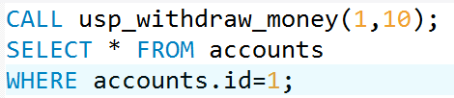
Problem: Withdraw Money
Create a stored procedure usp_withdraw_money (account_id, money_amount) that operate in transactions.
Validate only if the account is existing and if not throw an exception.
Check your solution here: https://judge.softuni.bg/Contests/Practice/Index/298#13

Slide 26
Solution: Withdraw Money (1)
Procedure Name
Parameters
CREATE PROCEDURE usp_withdraw_money (account_id INT, money_amount DECIMAL)
BEGIN
-- Transaction logic goes here.
END
Check your solution here: https://judge.softuni.bg/Contests/Practice/Index/298#13

Slide 27
Solution: Withdraw Money (2)
BEGIN
START TRANSACTION
UPDATE accounts SET balance = balance – money_amount
WHERE id = account_id;
IF(SELECT COUNT(*) FROM accounts
WHERE id = account_id) <> 1 THEN ROLLBACK;
END IF;
COMMIT;
END $$
Update Balance
Rollback
Save changes
Check your solution here: https://judge.softuni.bg/Contests/Practice/Index/298#13

Slide 28

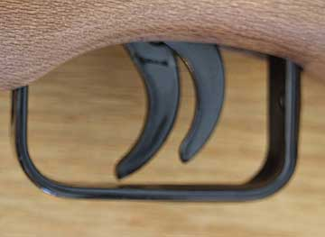
Triggers

Slide 29
What Are Triggers?
Triggers are very much like stored procedures.
Called in case of specific event.
We do not call triggers explicitly.
Triggers are attached to a table.
Triggers are fired when a certain SQL statement is executed against the contents of the table.
E.g. when a new row is inserted in given table.

Slide 30
MySQL Types of Triggers
Before
After
Trigger
Trigger
Event
Event
Notes:
There are two types of triggers
After triggers
Before triggers
Key words for getting data inside them are NEW and OLD

Slide 31
Events
There are three different events that can be applied within a trigger:
Events
Insert
Update
Delete

Slide 32
After Triggers
Trigger Name
DELIMITER $$
CREATE TRIGGER tr_delete_records
AFTER DELETE
ON employees_projects
FOR EACH ROW
BEGIN
INSERT INTO employees_projects_history
(employee_id, project_id)
VALUES(old.employee_id, old.project_id);
END $$
Trigger Type + Event
Table Name
Deleted Data

